Slide 1
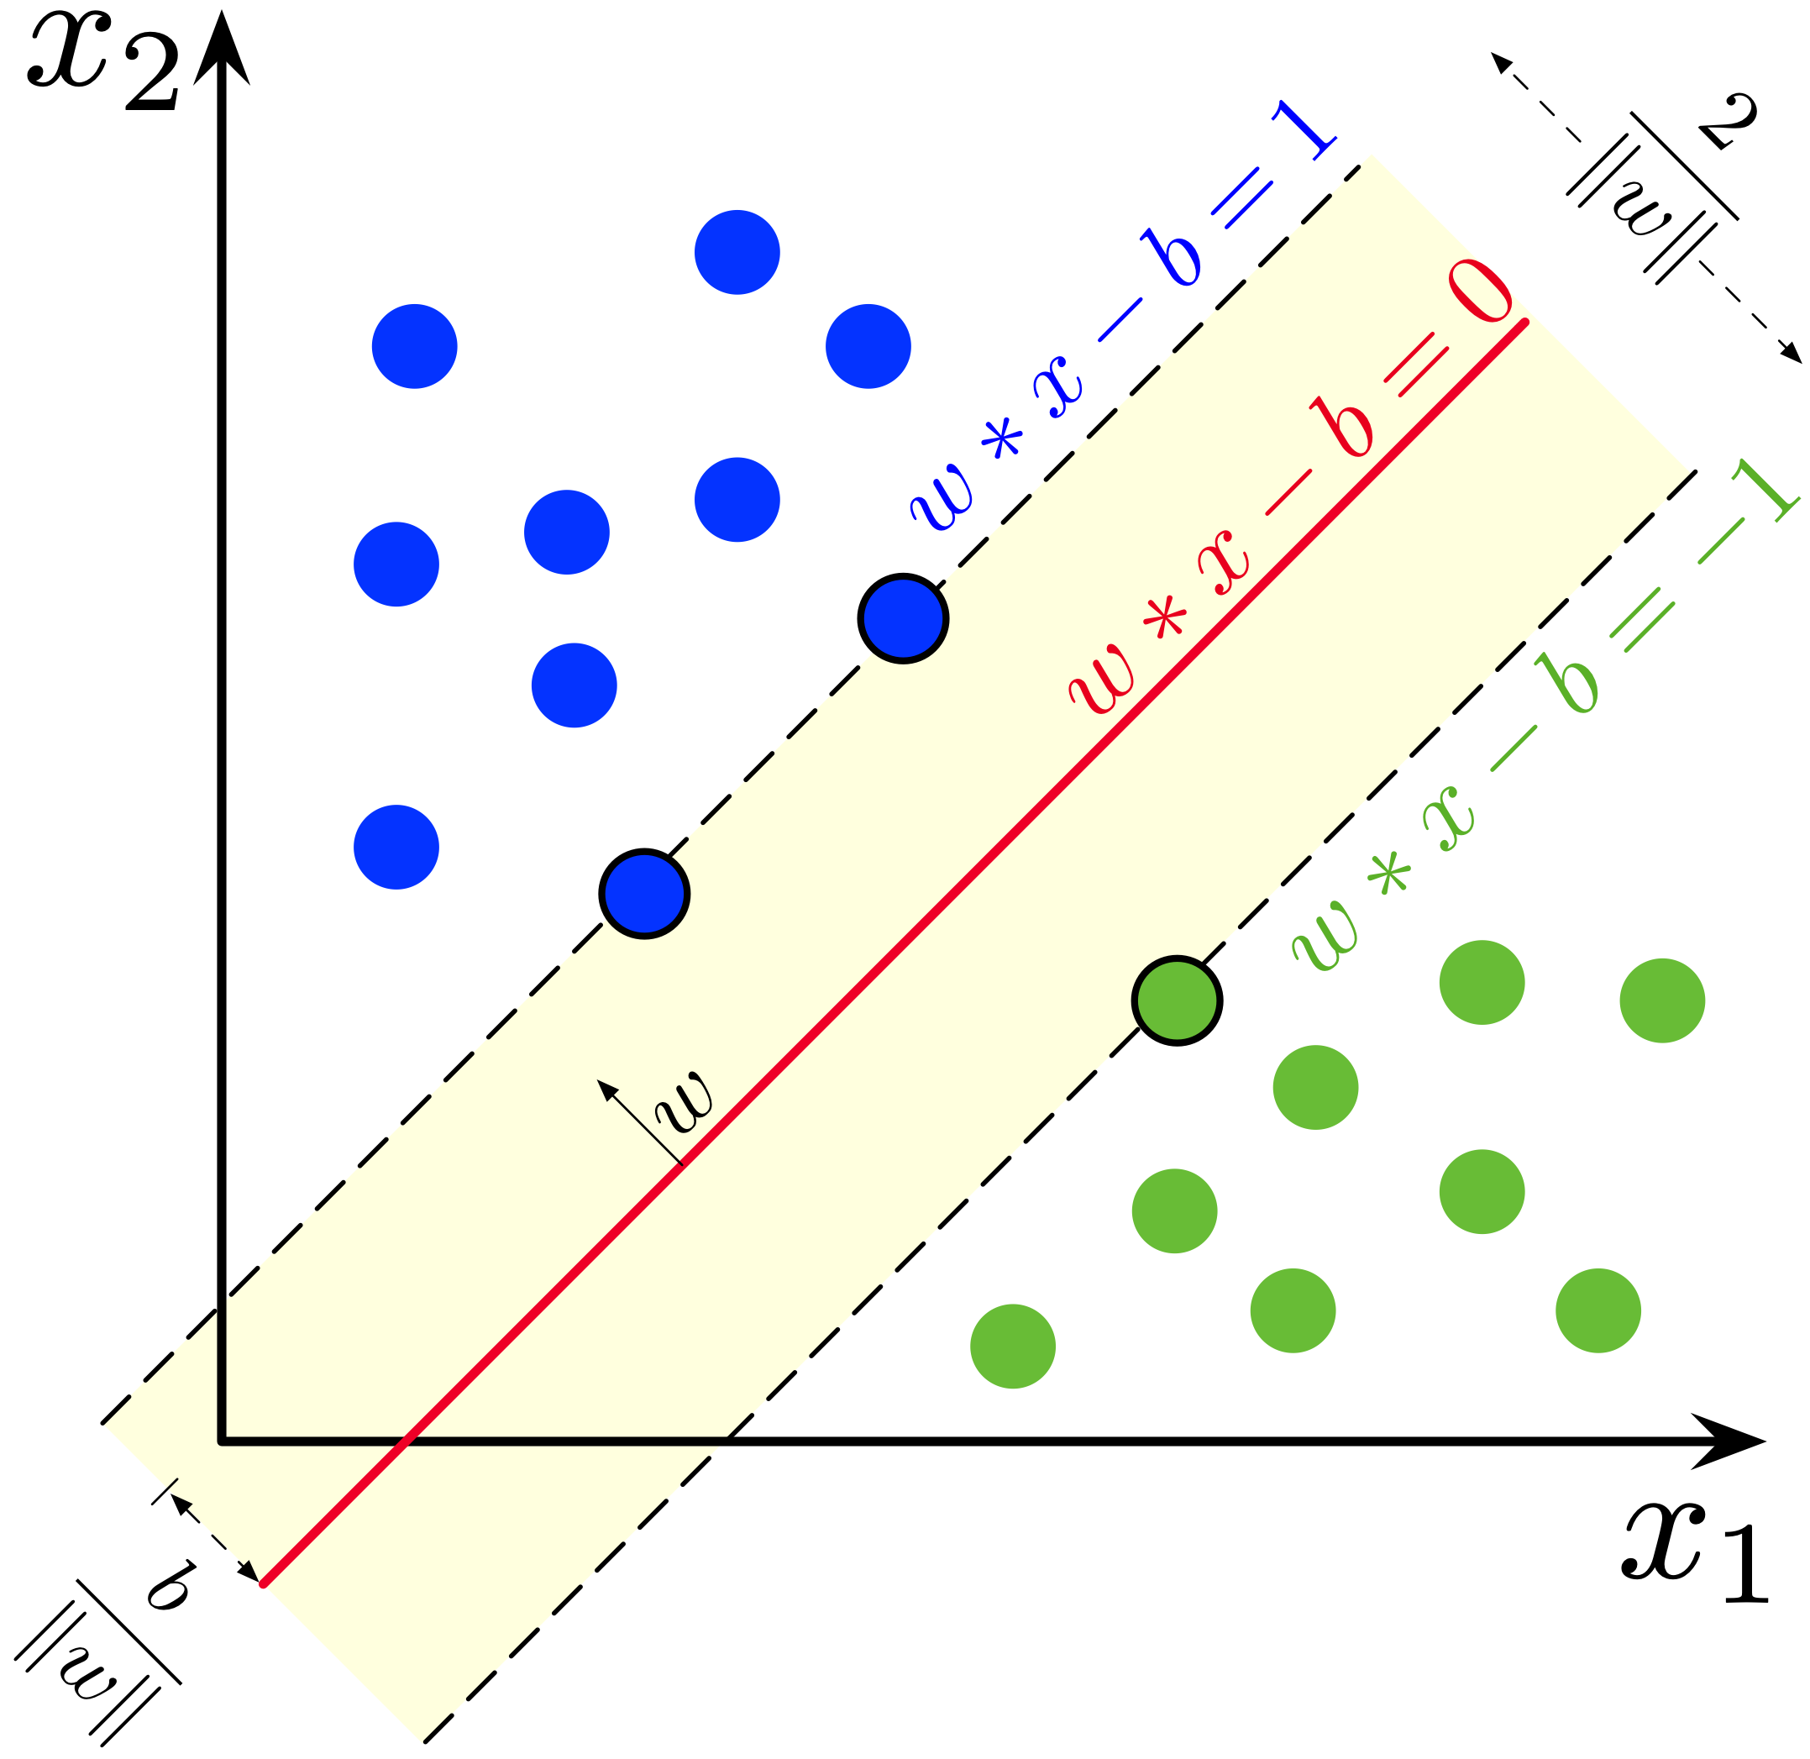
Data Science Camp
Support Vector Machine

Slide 2

This Lesson
SVM
Spam/Non-Spam classification

Slide 3
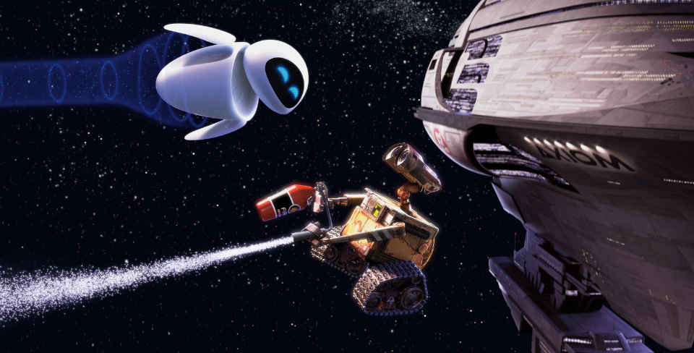
Support Vector Machine
Large Margin Classifier
Kernelized

Slide 4





SVM Hypothesis
Logistic Regression:
SVM (no probabilities just 1 or 0):

Slide 5
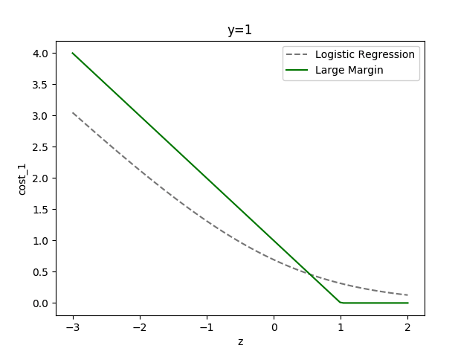


SVM Cost
Logistic Regression:
SVM:

Slide 6
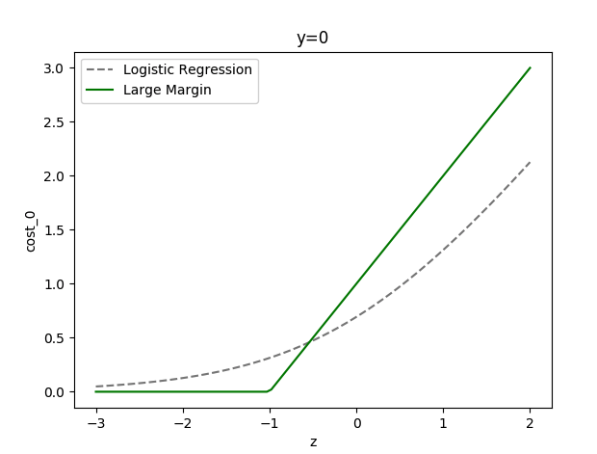


SVM Cost
Logistic Regression:
SVM:
Notes:
Note: both are plotting for cost as function of z not of x

Slide 7



SVM Cost Function
Logistic Regression:
SVM:

Slide 8

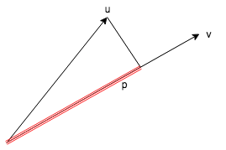
Projection on Vector
Notes:
Correct to V
It should be
cos(alpha) = u @ v / (|u|* |v|)
Then u @ v = | u | * | v |* cos(alpha) = | p | * | v |
Multiplication of len of vector and len of projection of another vector to it .

Slide 9

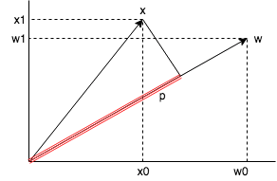

Notes:
Note: should be |w|^2 = sum(w_i^2) instead of |w| = sum(w_i^2)
Lets assume b = 0 to illustrate the effect
Lets observe the cost for y = 1
It gets reduced with z-> max till z>=1
So optimization leads to maximizing z
From other point |w| is regularization param so optimization leads to reducing |w|
Thus considering that z = |p| *|z| => it leads to increasing |p|
Since the w^2 is minimized it means the algorithm mathematically looks for p to max

Slide 10
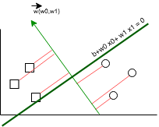
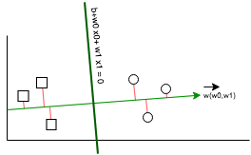
SVM Visualization
Small projections Large projections
Notes:
On the right side the projections are large - this is better decision boundary

Slide 11
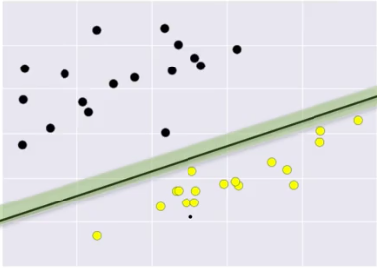
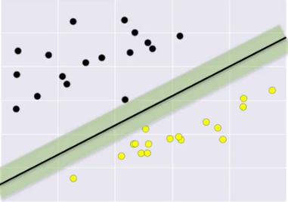
SVM Visualization
Small margin Large margin

Slide 12

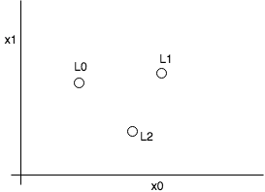
Gaussian Kernel
Notes:
If sigma is large then it is not such sensitive to distance between x and anchor l .
If sigma is small than it requires x very close to anchor l in order to have the f close to 1

Slide 13

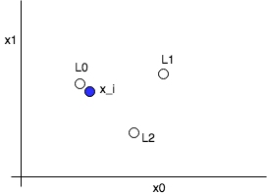

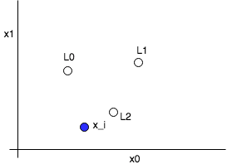
Gaussian Kernel

Slide 14
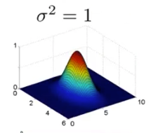
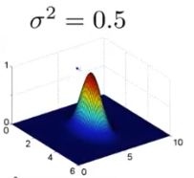
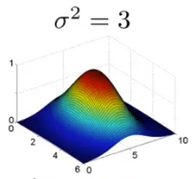
Gaussian Kernel
Notes:
The distance between x and l
If sigma is large then it is not such sensitive to distance between x and anchor l .
If sigma is small than it requires x very close to anchor l in order to have the f close to 1

Slide 15

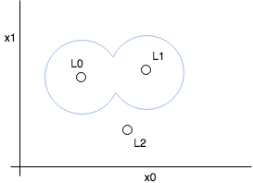
Sample Of Learned Hypothesis

Slide 16
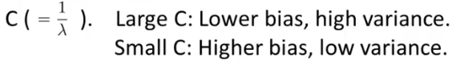
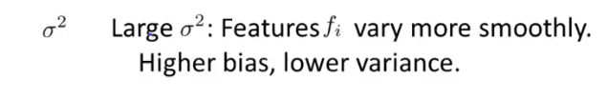
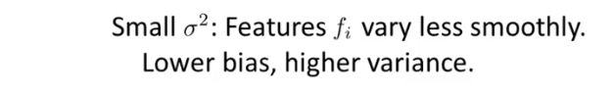
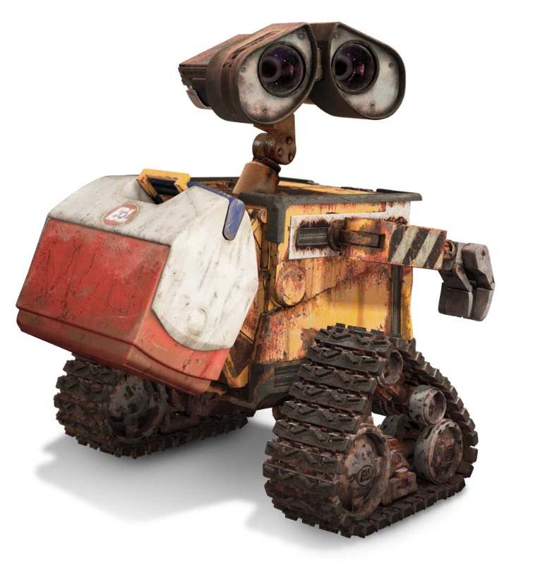
SVM Parameters
For linear regression:

Slide 17

Features As Transformation Of Data
Easily separated 1D data

Slide 18

Features As Transformation Of Data
More complex 1D data classification
For linear regression:

Slide 19
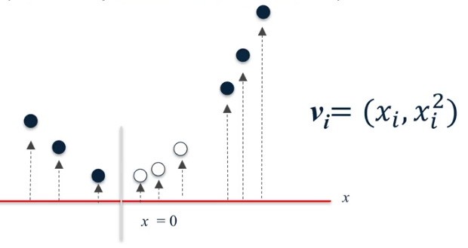
Features As Transformation Of Data
Transformation to 2D data
For linear regression:

Slide 20
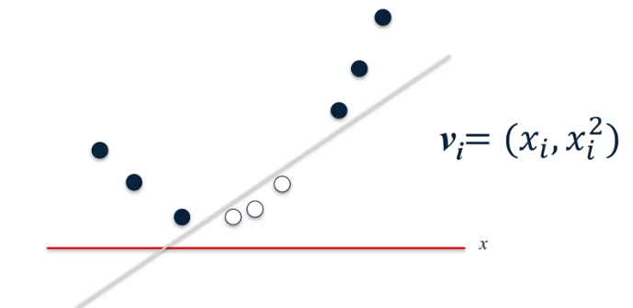
Features As Transformation Of Data
Transformation to 2D data - linearly separable
For linear regression:

Slide 21
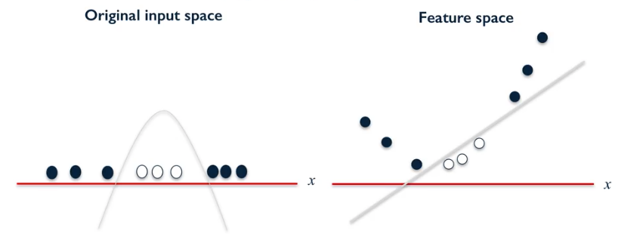
Features As Transformation Of Data
Transformation to 2D data - linearly separable

Slide 22
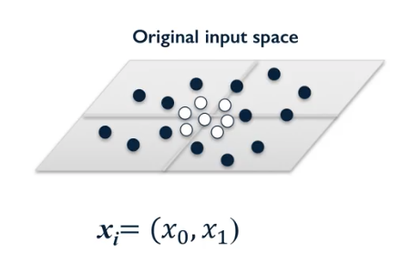
Features As Transformation Of Data
Transformation to 3D data
For linear regression:

Slide 23
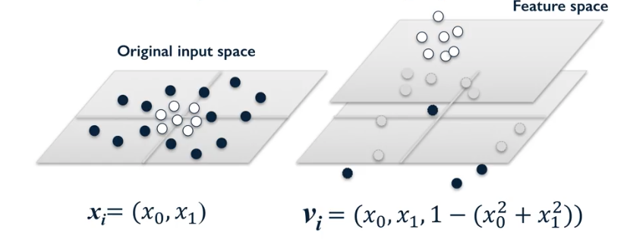
Features As Transformation Of Data
Transformation to 3D data - linearly separable
For linear regression:

Slide 24
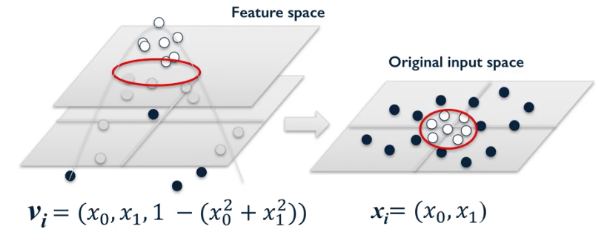
Features As Transformation Of Data
Transformation to 3D data - linearly separable

Slide 25
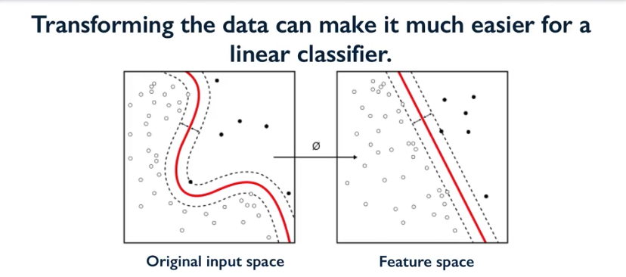

Slide 26


Slide 27
Sklearn LinearSVC
In:
from sklearn.svm import LinearSVC
X = df_fruits[['width', 'height']].values
y = df_fruits['fruit_label'].values
clf = LinearSVC(C=1).fit(X, y)
print("train accuracy= {:.3%}".format(clf.score (X, y)))
print ('b = {}\nw = {}'.format(clf.intercept_, clf.coef_))
Out:
train accuracy= 77.966%
b = [-1.25375074 0.86818087 -1.99529668 0.37785372]
w = [[ 0.40811419 -0.25819681]
[ 0.82485508 -1.15353295]
[ 0.29274118 -0.05291406]
[-1.3160097 1.05095549]]

Slide 28
Radial Basis Function
Radial Basis Functions (RBFs) are set of functions which have same value at a fixed distance from a given central point.
Gaussian Kernels with a covariance matrix which is diagonal and with constant variance will be radial in nature.
In SVMs, RBF Kernel and Gaussian Kernel are used interchangeably. But right way to specify is “Gaussian Radial Basis Function” because there can be other RBFs.

Slide 29
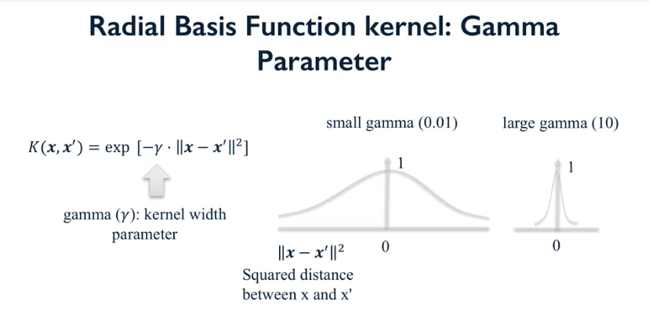

Slide 30
SVM - Gaussian RBF Kernel
In:
from sklearn.svm import SVC
X_mk8, y_mk8 = make_blobs(n_samples = 200, n_features = 2, centers = 8,
cluster_std = 1.3, random_state = 4)
y_train = y_mk8 % 2
clf = SVC(C=1).fit(X_mk8,y_train) # rbf is default
print("train accuracy= {:.3%}".format(clf.score (X_mk8,y_train)))
Out:
train accuracy= 94.000%
Sample of parameters:
kernel : string, optional (default=’rbf’)
Specifies the kernel type to be used in the algorithm. It must be one of ‘linear’, ‘poly’, ‘rbf’, ‘sigmoid’, ‘precomputed’ or a callable. If none is given, ‘rbf’ will be used.
* gamma : float, optional (default=’auto’)
Current default is ‘auto’ which uses 1/n_features

Slide 31
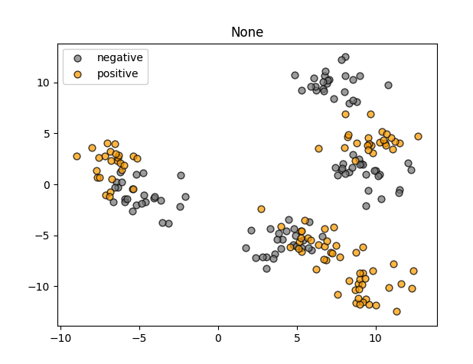
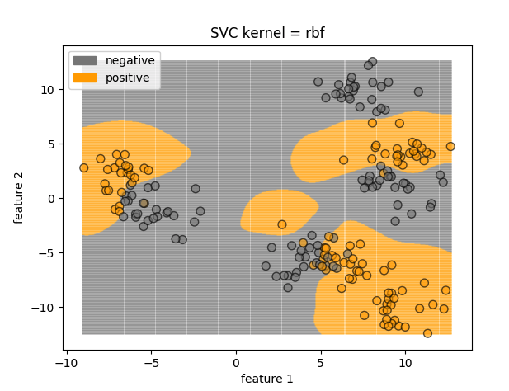
SVM - Gaussian RBF Kernel

Slide 32
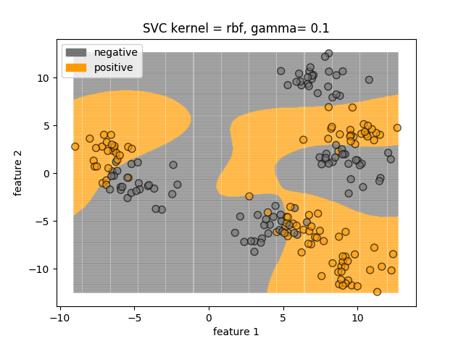
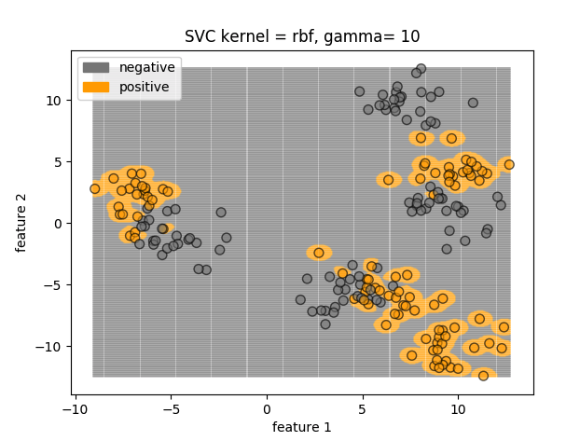
SVC parameters
Smaller gamma - stronger regularization
Large gamma tends to overfitting
Smaller C - stronger regularization

Slide 33
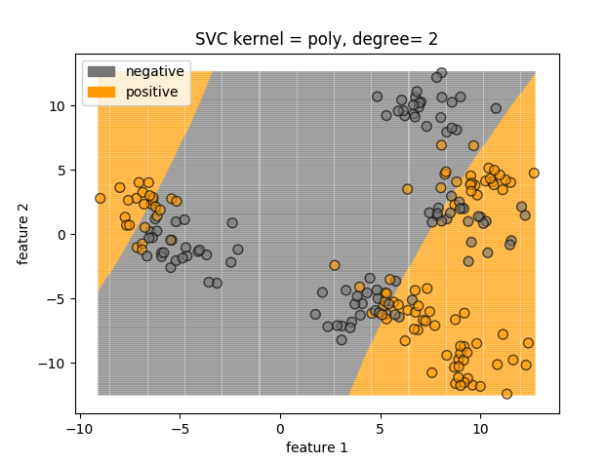
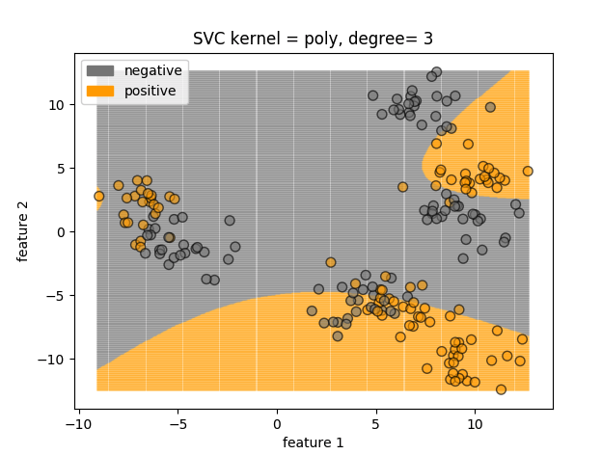
SVM - Polynomial Kernel
from sklearn.svm import SVC
clf = SVC(kernel= 'poly').fit(X_mk8,y_train) # default=3)
print("train accuracy= {:.3%}".format(clf.score (X_mk8,y_train))) # train accuracy= 72.500%

Slide 34
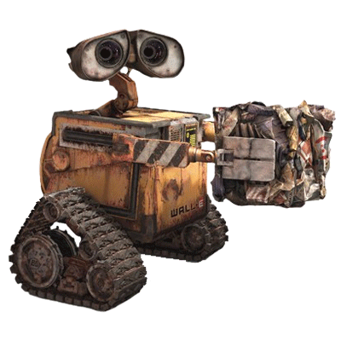
SVM vs Logistic Regression
If n >> m (e.g. n=10,000, m=10-1,000)
Use Logistic Regression or SVM linear kernel
If n is small m is intermediate (e.g. n=1-1,000, m=10-10,000)
Use SVM Gaussian Kernel
If n is small m is large (e.g. n=1-1,000, m=50,000+)
Add more features (e.g. polynomial)
and use Logistic Regression or SVM linear kernel
(Neural Network handles all cases but slower in training )

Slide 35

Spam/Non-Spam classification
Best Buy Viagra Generic Online
Viagra 100mg x 60 Pills $125, Free Pills & Reorder Discount, Top Selling 100% Quality & Satisfaction guaranteed!
We accept VISA, Master & E-Check Payments, 90000+ Satisfied Customers!
http://medphysitcstech.ru

Slide 36
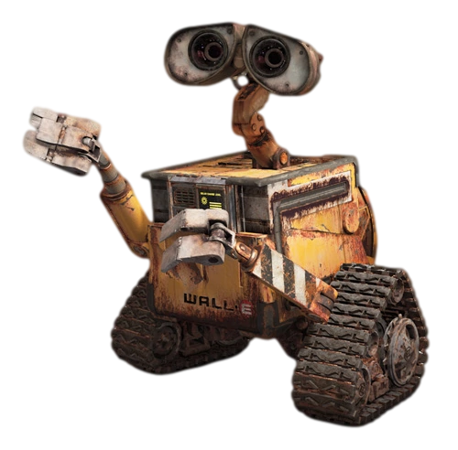
Home Task
Use sklearn.datasets.load_iris and apply SVM with linear, rbf and poly kernels
Follow by guide and complete the Spam/Non-Spam classifier

Slide 37
Learn more
Machine Learning (free of charge)
https://www.coursera.org/learn/machine-learning/
Applied Machine Learning in Python
https://www.coursera.org/learn/python-machine-learning
sklearn.svm.LinearSVC
https://scikit-learn.org/stable/modules/generated/sklearn.svm.LinearSVC.html
sklearn.svm.SVC
https://scikit-learn.org/stable/modules/generated/sklearn.svm.SVC.html
Python - Stemming Algorithms
https://www.tutorialspoint.com/python/python_stemming_algorithms.htm
Radial basis function kernel
https://en.wikipedia.org/wiki/Radial_basis_function_kernel
Notes:
All home task text is provided in handouts

Slide 38

Next Lesson
Classical neural networks
Handwritten digits recognition

Slide 39

THANKS!
Any questions?

